Slide 1
Fundamentals of Machine Learning
Il-Chul Moon Dept. of Industrial and Systems Engineering KAIST
icmoon@kaist.ac.kr

Slide 2
Weekly Objectives
Learn the most classical methods of machine learning
Rule based approach
Classical statistics approach
Information theory appraoch
Rule based machine learning
How to find the specialized and the generalized rules
Why the rules are easily broken
Decision Tree
How to create a decision tree given a training dataset
Why the tree becomes a weak learner with a new dataset
Linear Regression
How to infer a parameter set from a training dataset
Why the feature engineering has its limit

Slide 3
Rule based machine learning

Slide 4
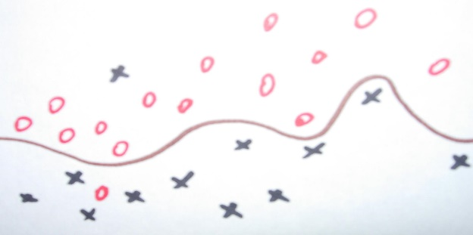
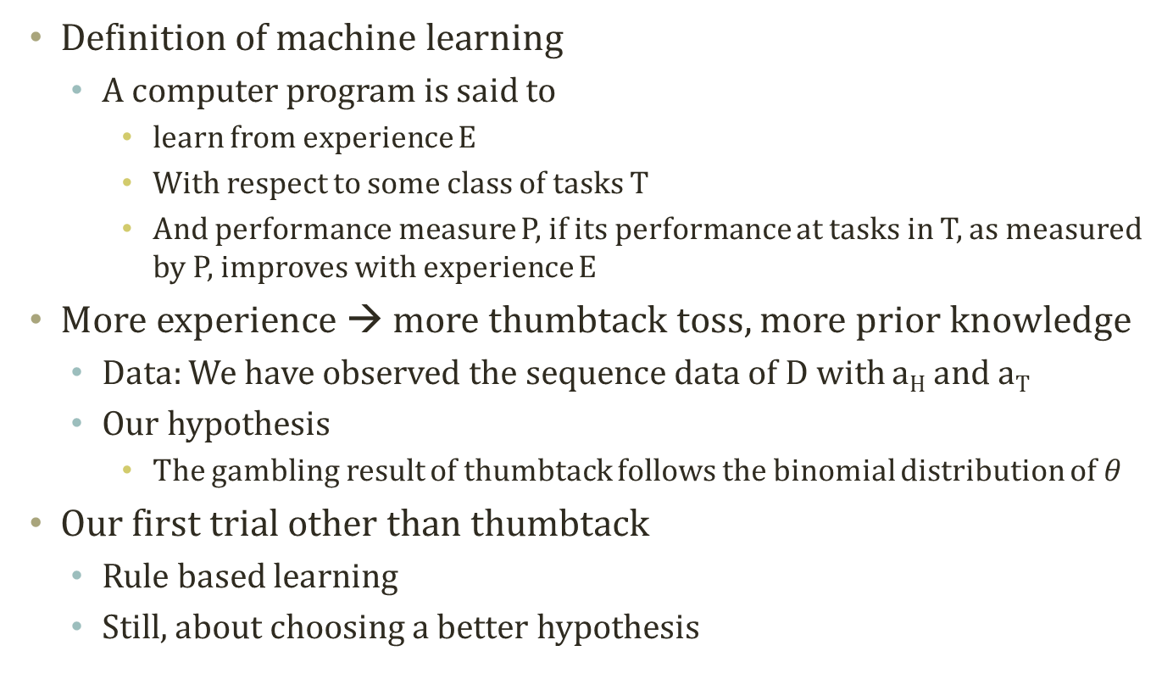
From the Last Week
Supervised Learning
You know the true answers of some of instances
Definition of machine learning
A computer program is said to
learn from experience E
With respect to some class of tasks T
And performance measure P, if its performance at tasks in T, as measured by P, improves with experience E
More experience → more thumbtack toss, more prior knowledge
Data: We have observed the sequence data of D with a_{H} and a_{T}
Our hypothesis
The gambling result of thumbtack follows the binomial distribution of $θ$
Our first trial other than thumbtack
Rule based learning
Still, about choosing a better hypothesis

Slide 5
A Perfect World for Rule Based Learning
Training data is error-free, noise-free
Imagine
A perfect world with
No observation errors, No inconsistent observations
No stochastic elements in the system we observe
Full information in the observations to regenerate the system
A perfect world of “EnjoySport”
Observation on the people
Sky, Temp, Humid, Wind, Water, Forecast → EnjoySport
Target function is deterministic
Target function is contained in hypotheses set
Sky | Temp | Humid | Wind | Water | Forecst | EnjoySpt
Sunny | Warm | Normal | Strong | Warm | Same | Yes
Sunny | Warm | High | Strong | Warm | Same | Yes
Rainy | Cold | High | Strong | Warm | Change | No
Sunny | Warm | High | Strong | Cool | Change | Yes

Slide 6
Function Approximation
Machine Learning?
The effort of producing a better approximate function
Remember PAC Learning Theory?
In the perfect world of EnjoySport
Instance X
Features: O: <Sunny, Warm, Normal, Strong, Warm, Same>
Label: Y: <Yes>
Training Dataset D
A collection of observations on the instance
Hypotheses H
Potentially possible function to turn X into Y
h_{i}: <Sunny, Warm, ?, ?, ?, Same> → Yes
How many hypotheses exist?
Target Function c
Unknown target function between the features and the label
Determine
A hypothesis h in H such that h(x)=c(x) for all x in X
Determine
A hypothesis h in H such that h(x)=c(x) for all x in D

Slide 7
Graphical Representation of Function Approximation
Instances X
Hypotheses H
Specific
x₃
x₁
h₃
h₂
x₂
h₁
X_{with_no}
x₁: <Sunny, Warm, Normal, Strong, Warm, Same>
h₁: <Sunny, ?, ?, ?, Warm, ?>
General
x₂: <Sunny, Warm, Normal, Light, Warm, Same>
h₂: <Sunny, ?, ?, ?, Warm, Same>
x₃: <Sunny, Warm, Normal, Strong, Warm, Change>
h₃: <Sunny, ?, ?, Strong, Warm, ?>
What would be the better function approximation?
Generalization vs. Specialization

Slide 8
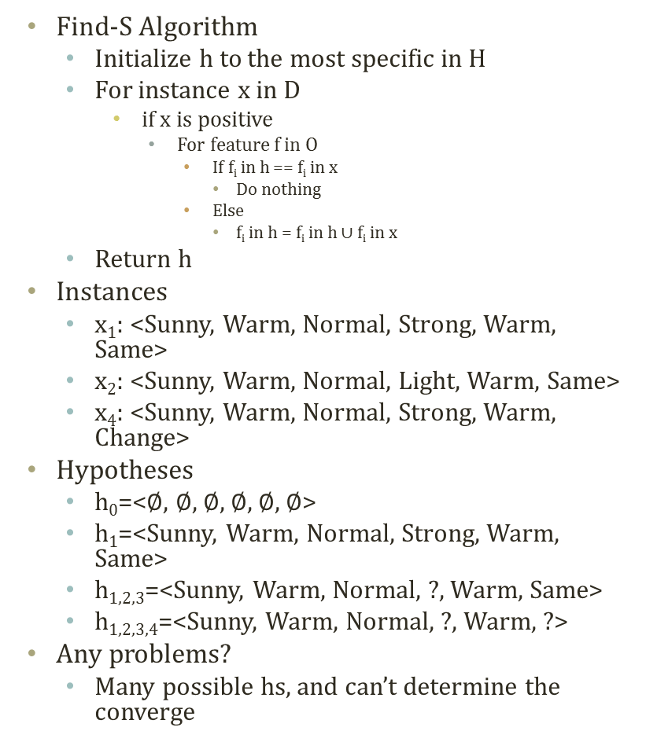
Find-S Algorithm
Instances X
x₄
Find-S Algorithm
Initialize h to the most specific in H
For instance x in D
if x is positive
For feature f in O
If f_{i} in h == f_{i} in x
Do nothing
Else
f_{i} in h = f_{i} in h ∪ f_{i} in x
Return h
Instances
x₁: <Sunny, Warm, Normal, Strong, Warm, Same>
x₂: <Sunny, Warm, Normal, Light, Warm, Same>
x₄: <Sunny, Warm, Normal, Strong, Warm, Change>
Hypotheses
h₀=<$∅$, $∅$, $∅$, $∅$, $∅$, $∅$>
h₁=<Sunny, Warm, Normal, Strong, Warm, Same>
h_{1,2,3}=<Sunny, Warm, Normal, ?, Warm, Same>
h_{1,2,3,4}=<Sunny, Warm, Normal, ?, Warm, ?>
Any problems?
Many possible hs, and can’t determine the converge
x₁
x₂
x₃
Hypotheses H
h₀
h₁
h_{1,2,3}
h_{1,2,3,4}

Slide 9
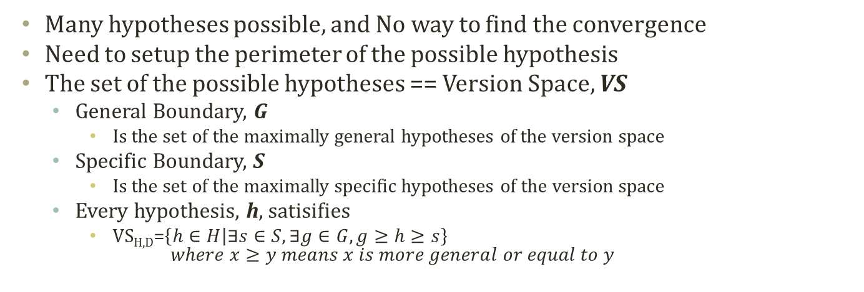
Version Space
Many hypotheses possible, and No way to find the convergence
Need to setup the perimeter of the possible hypothesis
The set of the possible hypotheses == Version Space, VS
General Boundary, G
Is the set of the maximally general hypotheses of the version space
Specific Boundary, S
Is the set of the maximally specific hypotheses of the version space
Every hypothesis, h, satisifies
VS_{H,D}=$\left\{h∈H | ∃s∈S,∃g∈G,g≥h≥s\right\}$ $where x≥y means x is more general or equal to y$
S: {<Sunny, Warm, ?, Strong, ?, ?>}
<Sunny, ?,?,Strong,?,?>
<Sunny, Warm,?,?,?,?>
<?, Warm,?,Strong,?,?>
G: {<Sunny, ?,?,?,?,?>, <?,Warm, ?, ?, ?, ?>}
Sky | Temp | Humid | Wind | Water | Forecst | EnjoySpt
Sunny | Warm | Normal | Strong | Warm | Same | Yes
Sunny | Warm | High | Strong | Warm | Same | Yes
Rainy | Cold | High | Strong | Warm | Change | No
Sunny | Warm | High | Strong | Cool | Change | Yes

Slide 10

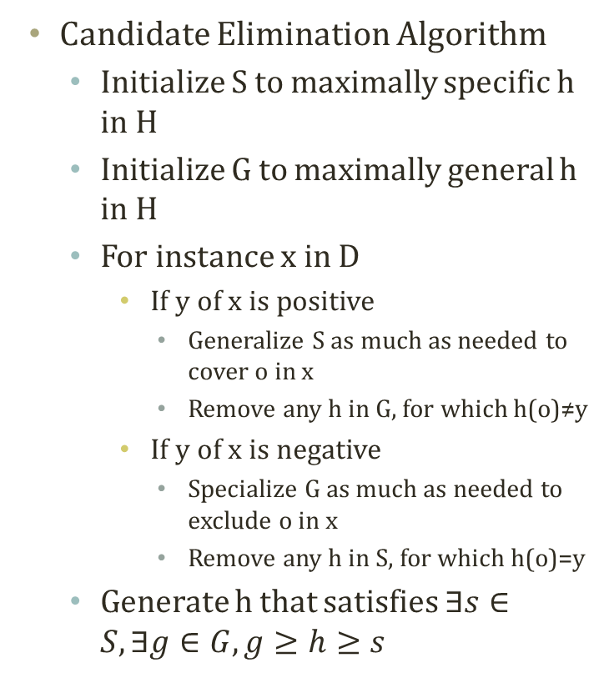
Candidate Elimination Algorithm
Candidate Elimination Algorithm
Initialize S to maximally specific h in H
Initialize G to maximally general h in H
For instance x in D
If y of x is positive
Generalize S as much as needed to cover o in x
Remove any h in G, for which h(o)≠y
If y of x is negative
Specialize G as much as needed to exclude o in x
Remove any h in S, for which h(o)=y
Generate h that satisfies $∃s∈S,∃g∈G,g≥h≥s$
S0: {<$∅$, $∅$, $∅$, $∅$, $∅$, $∅$>}
G0: {<?,?,?,?,?,?>}

Slide 11

Progress of Candidate Elimination Algorithm
Sky | Temp | Humid | Wind | Water | Forecst | EnjoySpt
Sunny | Warm | Normal | Strong | Warm | Same | Yes
Sunny | Warm | High | Strong | Warm | Same | Yes
Rainy | Cold | High | Strong | Warm | Change | No
Sunny | Warm | High | Strong | Cool | Change | Yes
S0: {<$∅$, $∅$, $∅$, $∅$, $∅$, $∅$>}
S1: {<Sunny, Warm, Normal, Strong, Warm, Same>}
S2: {<Sunny, Warm, ?, Strong, Warm, Same>}
G0, G1, G2: {<?,?,?,?,?,?>}

Slide 12
Progress of Candidate Elimination Algorithm
Sky | Temp | Humid | Wind | Water | Forecst | EnjoySpt
Sunny | Warm | Normal | Strong | Warm | Same | Yes
Sunny | Warm | High | Strong | Warm | Same | Yes
Rainy | Cold | High | Strong | Warm | Change | No
Sunny | Warm | High | Strong | Cool | Change | Yes
S0: {<$∅$, $∅$, $∅$, $∅$, $∅$, $∅$>}
S1: {<Sunny, Warm, Normal, Strong, Warm, Same>}
S2, S3: {<Sunny, Warm, ?, Strong, Warm, Same>}
G3: {<Sunny,?,?,?,?,?>, <?,Warm,?,?,?,?>, <?,?,?,?,?,Same>}
G0, G1, G2: {<?,?,?,?,?,?>}

Slide 13

Progress of Candidate Elimination Algorithm
Hypotheses H
Sky | Temp | Humid | Wind | Water | Forecst | EnjoySpt
Sunny | Warm | Normal | Strong | Warm | Same | Yes
Sunny | Warm | High | Strong | Warm | Same | Yes
Rainy | Cold | High | Strong | Warm | Change | No
Sunny | Warm | High | Strong | Cool | Change | Yes
S0: {<$∅$, $∅$, $∅$, $∅$, $∅$, $∅$>}
S1: {<Sunny, Warm, Normal, Strong, Warm, Same>}
S2, S3: {<Sunny, Warm, ?, Strong, Warm, Same>}
S4: {<Sunny, Warm, ?, Strong, ?, ?>}
Still many hs
G4: {<Sunny,?,?,?,?,?>, <?,Warm,?,?,?,?>}
G3: {<Sunny,?,?,?,?,?>, <?,Warm,?,?,?,?>, <?,?,?,?,?,Same>}
G0, G1, G2: {<?,?,?,?,?,?>}

Slide 14



How to classify the next instance?
Sky | Temp | Humid | Wind | Water | Forecst | EnjoySpt
Sunny | Warm | Normal | Strong | Warm | Same | Yes
Sunny | Warm | High | Strong | Warm | Same | Yes
Rainy | Cold | High | Strong | Warm | Change | No
Sunny | Warm | High | Strong | Cool | Change | Yes
S: {<Sunny, Warm, ?, Strong, ?, ?>}
$h_{1}$= <Sunny, ?,?,Strong,?,?>
$h_{2}$= <Sunny, Warm,?,?,?,?>
$h_{3}$= <?, Warm,?,Strong,?,?>
G: {<Sunny, ?,?,?,?,?>, <?,Warm, ?, ?, ?, ?>}
Somehow, we come up with the version space
A subset of H that satisfies the training data, D
Imagine a new instance kicks in
<Sunny, Warm, Normal, Strong, Cool, Change>
<Rainy, Cold, Normal, Light, Warm, Same>
<Sunny, Warm, Normal, Light, Warm, Same>
How to classify these?
Which h to apply from the subset?
Or, a classification by all of hs in the subset
How many are hs satisfied?

Slide 15
Is this working?
Will the candidate-elimination algorithm converge to the correct hypothesis?
Converge? → Able to select a hypothesis
Correct? → The hypothesis is true in the observed system
Given the assumption, yes and yes
No observation errors, No inconsistent observations
No stochastic elements in the system we observe
Full information in the observations to regenerate the system
However, we don’t live in the perfect world
Any noise in o of x in D
Decision factor other than o of x
a correct h can be removed by the noise
Cannot say yes and no
Training data is error-free, noise-free
Target function is deterministic
Target function is contained in hypotheses set

Slide 16
Decision tree

Slide 17
Because we live with noises…
Sky | Temp | Humid | Wind | Water | Forecst | EnjoySpt
Sunny | Warm | Normal | Strong | Warm | Same | Yes
Sunny | Warm | High | Strong | Warm | Same | Yes
Rainy | Cold | High | Strong | Warm | Change | No
Sunny | Warm | High | Strong | Cool | Change | Yes
We need a better learning method
We need to have more robust methods given the noises
We need to have more concise presentations of the hypotheses
One alternative is a decision tree
Sky
<Sunny, ?,?,?,?,?>
Rainy
Sunny
No
Yes
Sky
<Sunny, Warm, ?, Strong, ?, ?>
Rainy
Sunny
No
Temp
Only one potential decision tree corresponding to the hypothesis
Cold
Warm
No
Wind
Light
Strong
Yes
No

Slide 18
Credit Approval Dataset
Some Counting Result
690 instances total
307 positive instances
Considering A1
98 positive when a
112 negative when a
206 positive when b
262 negative when b
3 positive when ?
9 negative when ?
Considering A9
284 positive when t
77 negative when t
23 positive when f
306 negative when f
http://archive.ics.uci.edu/ml/datasets/Credit+Approval
To protect the confidential information, the dataset is anonymized
Feature names and values, as well
A1: b, a. A2: continuous. A3: continuous. A4: u, y, l, t. A5: g, p, gg. A6: c, d, cc, i, j, k, m, r, q, w, x, e, aa, ff. A7: v, h, bb, j, n, z, dd, ff, o. A8: continuous. A9: t, f. A10: t, f. A11: continuous. A12: t, f. A13: g, p, s. A14: continuous. A15: continuous. C: +,- (class attribute)
A1 (307+,383-)
A9 (307+,383-)
a
b
?
t
f
98+,112-
206+,
262-
3+,9-
284+,77-
23+,306-
Which is a better attribute to include in the feature set of the hypothesis?

Slide 19
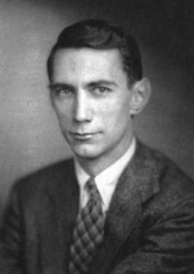
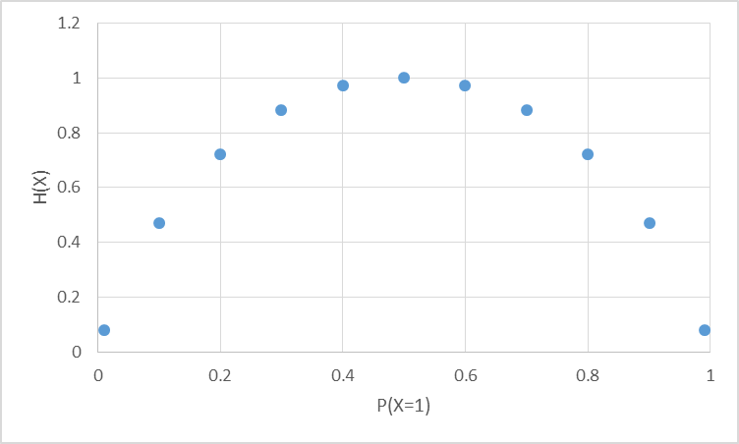
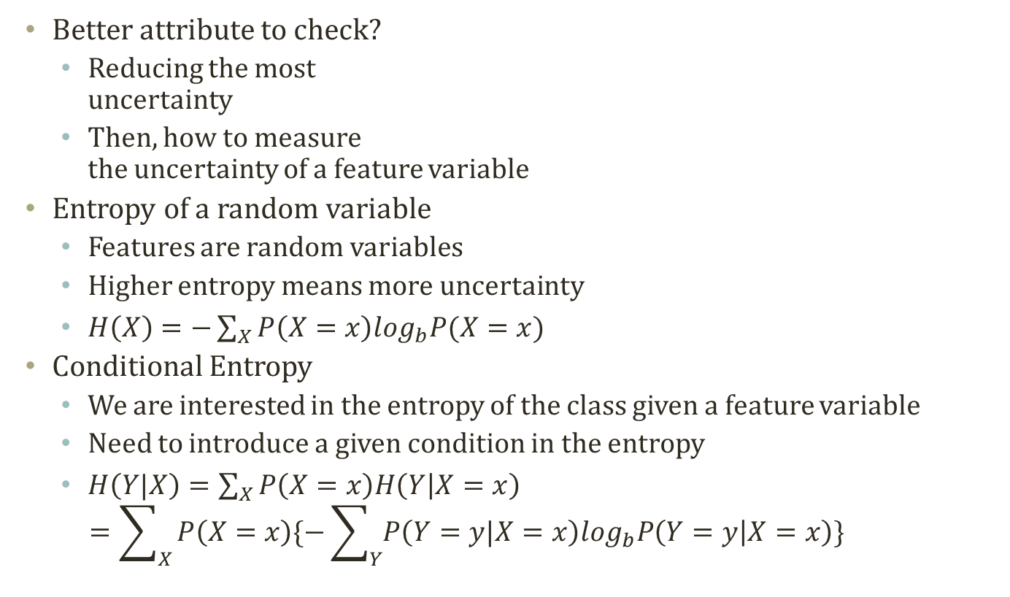
Entropy
Most random case
Better attribute to check?
Reducing the most uncertainty
Then, how to measure the uncertainty of a feature variable
Entropy of a random variable
Features are random variables
Higher entropy means more uncertainty
$H\left(X\right)=−\sum_{X}{P\left(X=x\right)\log_{b}P(X=x)}$
Conditional Entropy
We are interested in the entropy of the class given a feature variable
Need to introduce a given condition in the entropy
$H\left(Y|X\right)=\sum_{X}{P\left(X=x\right)H\left(Y | X=x\right)}$ $=\sum_{X}{P\left(X=x\right)\{−\sum_{Y}{P\left(Y=y|X=x\right)\log_{b}P\left(Y=y | X=x\right)}\}}$
All instances are X=0
All instances are X=1

Slide 20
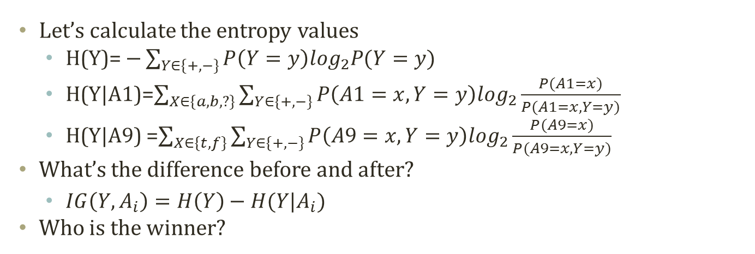
Information Gain
Entropy Before Decision Node
A1 (307+,383-)
A9 (307+,383-)
a
b
?
t
f
98+,112-
206+,
262-
3+,9-
284+,77-
23+,306-
Entropy After Decision Node A1
Entropy After Decision Node A9
Let’s calculate the entropy values
H(Y)= $−\sum_{Y∈\{+,−\}}{P\left(Y=y\right)\log_{2}P(Y=y)}$
H(Y|A1)=$\sum_{X∈\{a,b,?\}}{\sum_{Y∈\{+,−\}}{P\left(A1=x,Y=y\right)\log_{2}\frac{P(A1=x)}{P(A1=x,Y=y)}}}$
H(Y|A9) =$\sum_{X∈\{t,f\}}{\sum_{Y∈\{+,−\}}{P\left(A9=x,Y=y\right)\log_{2}\frac{P(A9=x)}{P(A9=x,Y=y)}}}$
What’s the difference before and after?
$IG\left(Y,A_{i}\right)=H\left(Y\right)−H(Y|A_{i})$
Who is the winner?

Slide 21
Top-Down Induction Algorithm
Only using A1 and A9, we have 21+56+0+5+17+1 (100) instances classified inaccurately. (85.5% Accr.)
Many, many variations in learning a decision tree
ID3, C4.5 CART….
One example: ID3 algorithm
ID3 algorithm
Create an initial open node
Put instances in the initial node
Repeat until no open node
Select an open node to split
Select a best variable to split
For values of the selected variable
Sort instances with the value of the selected variable
Put the sorted items under the branch of the value of the variable
If the sorted items are all in one class
Close the leaf node of the branch
A9 (307+,383-)
t
f
A1 (284+,77-)
A1 (23+,306-)
a
a
b
?
b
93+,21-
5+,91-
17+, 206-
1+,9-
?
Class+
189+,56-
Class-
Class-
Class-
Class+
2+,0-
Class+

Slide 22
If you want more….
Let’s say A10 has the next best information gain.
A9 (307+,383-)
f
t
A1 (284+,77-)
A1 (23+,306-)
a
b
?
a
b
?
A10 (93+,21-)
189+,56-
2+,0-
5+,91-
17+, 206-
1+,9-
f
Class+
Class+
Class-
Class-
Class-
t
In this decision tree, the incorrect classification occurred for 5+17+1+56+7+5+7+1 (99) instances.
(85.6% Accr.)
69+,7-
A12 (24+,14-)
Class+
t
f
14+,5-
A5 (10+,9-)
Class+
gg
g
p
0+,0-
9+,7-
1+,2-
Class+
Class-

Slide 23
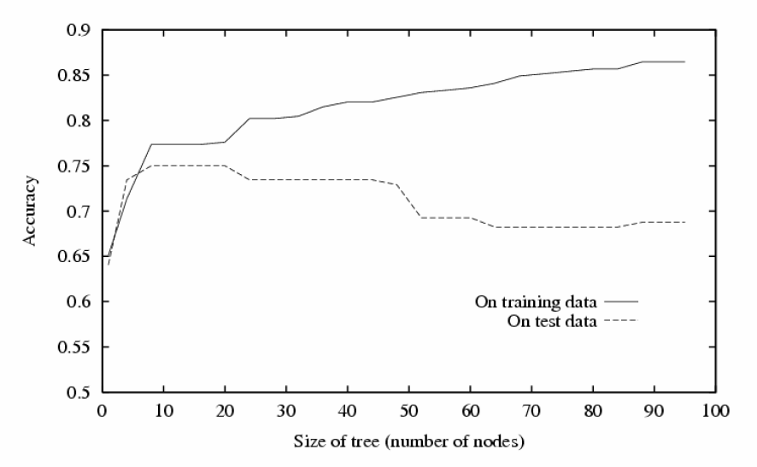
Problem of Decision Tree
Typical result of decision tree
We did better in the given dataset!
Only in the given experience, a.k.a. Training dataset
What if we deploy the created decision tree in the field?
World has so much noise and inconsistencies.
The training dataset will not be a perfect sample of the real world
Noise
Inconsistencies
Should have stopped here!
Knowing when to stop is a pretty difficult task. How to do it?
- Pruning by divided dataset?
- Path length penalty?

Slide 24
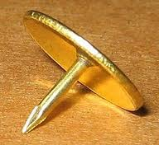
Why we are not interested in these?
Rule based machine learning algorithms
Easy to implement
Easily interpretable
Particularly, decision tree
Their weaknesses
Fragile
Assume the perfect world in the dataset
Any new observations, contradicting to the training, will cause problems
Convergence
Convergence only guaranteed in the perfect dataset
Once there is a noise, there is a possibility that the true hypothesis can be ruled out.
Also, very hard to tell when to stop in some cases
Still used in many places
Easy → Wide audience and users → Many applications → Better result???
Need a white knight as a savior
Should be able to handle noisy datasets
Robust to errors
Believe the small dataset?
(5/6→ Head with 83.3% prob?)

Slide 25
Linear Regression

Slide 26
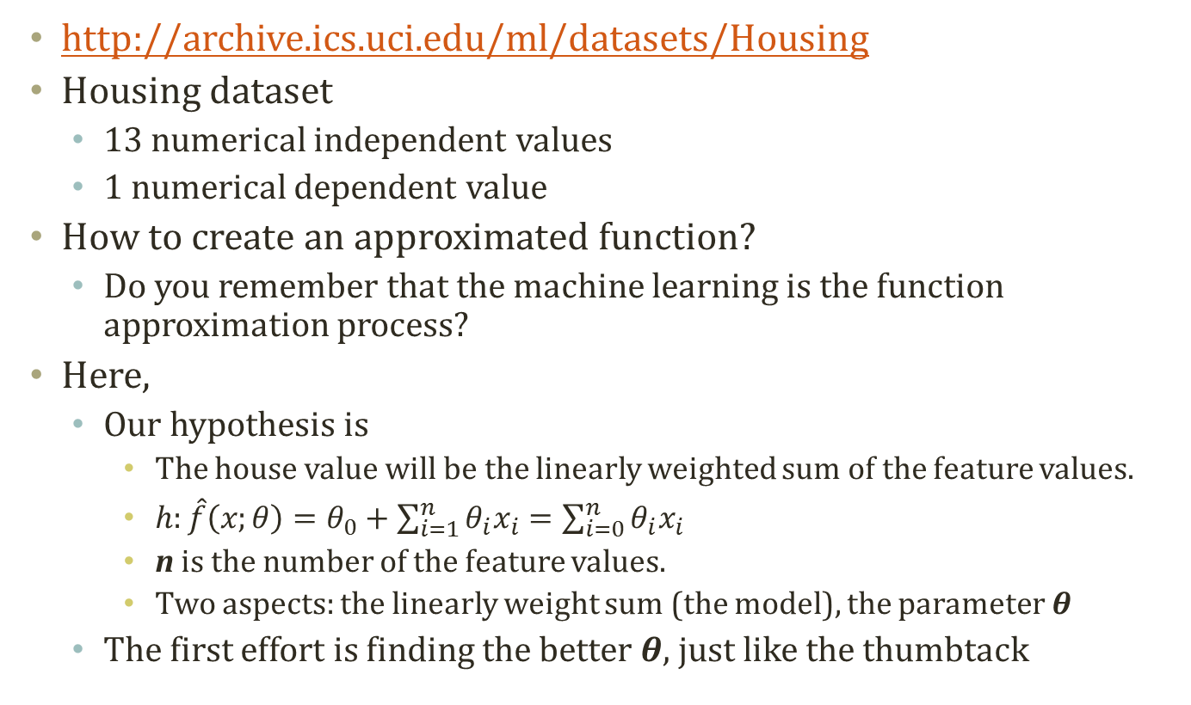
How about statistical approach?
http://archive.ics.uci.edu/ml/datasets/Housing
Housing dataset
13 numerical independent values
1 numerical dependent value
How to create an approximated function?
Do you remember that the machine learning is the function approximation process?
Here,
Our hypothesis is
The house value will be the linearly weighted sum of the feature values.
$h:\hat{f}\left(x;θ\right)=θ_{0}+\sum_{i=1}^{n}{θ_{i}x_{i}}=\sum_{i=0}^{n}{θ_{i}x_{i}}$
n is the number of the feature values.
Two aspects: the linearly weight sum (the model), the parameter $θ$
The first effort is finding the better $θ$, just like the thumbtack

Slide 27
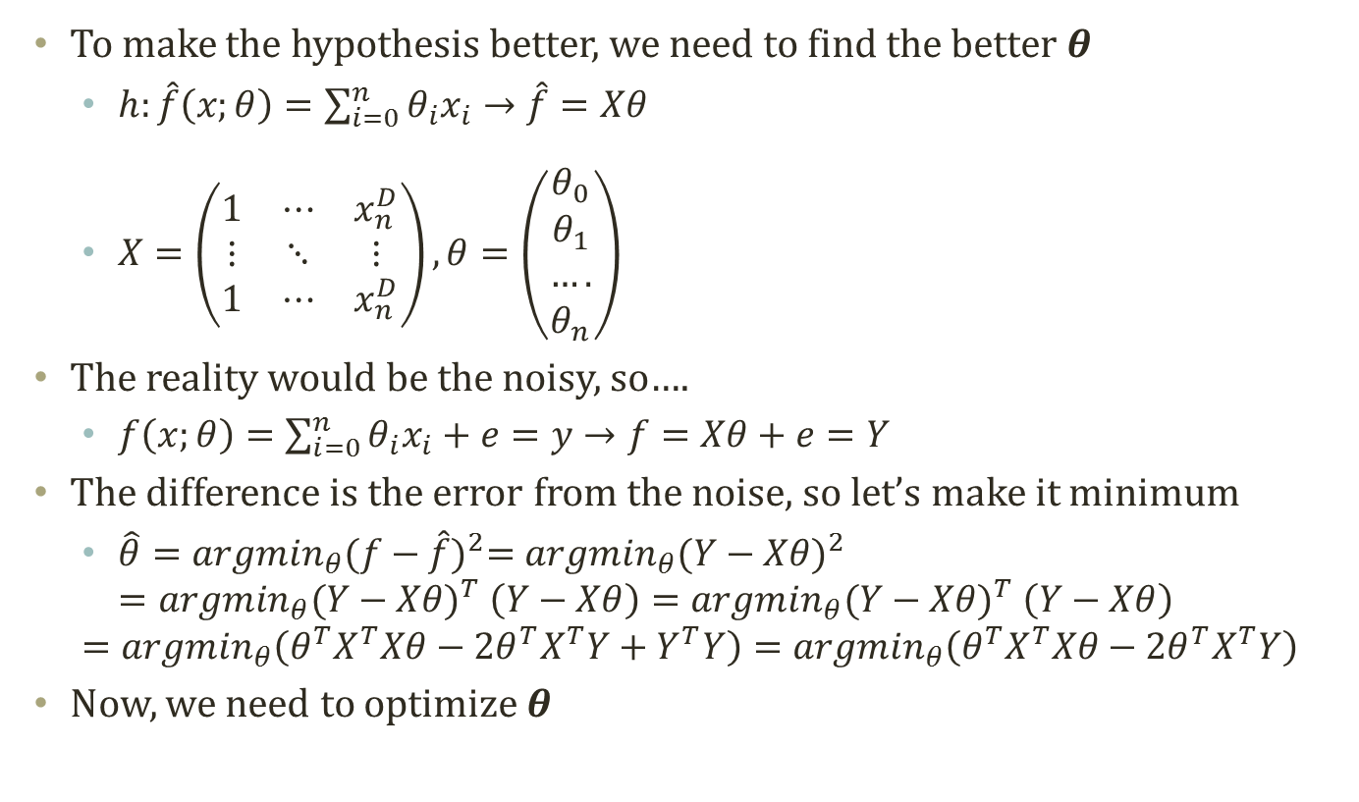
Finding 𝜽 in Linear Regression
To make the hypothesis better, we need to find the better 𝜽
$h:\hat{f}\left(x;θ\right)=\sum_{i=0}^{n}{θ_{i}x_{i}}→\hat{f}=Xθ$
$X=\left(\begin{matrix}1 & ⋯ & x_{n}^{D} \\ ⋮ & ⋱ & ⋮ \\ 1 & ⋯ & x_{n}^{D}\end{matrix}\right), θ=\left(\begin{aligned}θ_{0} \\ θ_{1} \\ …. \\ θ_{n}\end{aligned}\right)$
The reality would be the noisy, so….
$f\left(x;θ\right)=\sum_{i=0}^{n}{θ_{i}x_{i}}+e=y→f=Xθ+e=Y$
The difference is the error from the noise, so let’s make it minimum
$\hat{θ}={argmin}_{θ}{(f−\hat{f})}^{2}={argmin}_{θ}{(Y−Xθ)}^{2}$ $={argmin}_{θ}{(Y−Xθ)}^{T}$ $\left(Y−Xθ\right)={argmin}_{θ}{(Y−Xθ)}^{T} \left(Y−Xθ\right)$
$$={argmin}_{θ}\left(θ^{T}X^{T}Xθ−2θ^{T}X^{T}Y+Y^{T}Y\right)={argmin}_{θ}\left(θ^{T}X^{T}Xθ−2θ^{T}X^{T}Y\right)$$
Now, we need to optimize $θ$

Slide 28
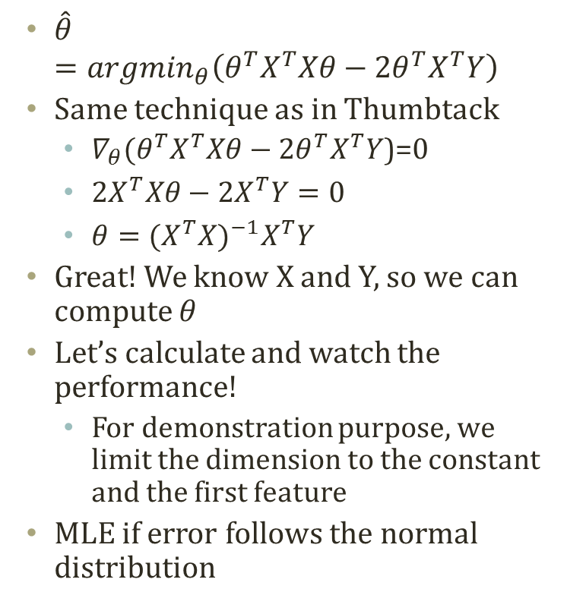

Optimized $θ$
Red: True,
Blue: Estimated
$\hat{θ}$ $={argmin}_{θ}\left(θ^{T}X^{T}Xθ−2θ^{T}X^{T}Y\right)$
Same technique as in Thumbtack
$∇_{θ}(θ^{T}X^{T}Xθ−2θ^{T}X^{T}Y$)=0
$2X^{T}Xθ−2X^{T}Y=0$
$θ={(X^{T}X)}^{−1}X^{T}Y$
Great! We know X and Y, so we can compute $θ$
Let’s calculate and watch the performance!
For demonstration purpose, we limit the dimension to the constant and the first feature
MLE if error follows the normal distribution
House value, y
The first feature value

Slide 29
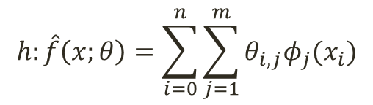
If you want more….
Actually, you can increase the number of features, a.k.a. dimension
You have a value x in the previous fitted figure
How about adding x², x³, x⁴….?
You can improve the result!
Is that right?
We are going to come back!
$$h:\hat{f}\left(x;θ\right)=\sum_{i=0}^{n}{\sum_{j=1}^{m}{θ_{i,j}φ_{j}(x_{i})}}$$
Better Fitting?
Better Fitting?

Slide 30
Too Brittle to Be Used Naively
A9 (307+,383-)
t
f
A1 (284+,77-)
A1 (23+,306-)
a
b
?
a
b
?
A10 (93+,21-)
189+,56-
2+,0-
5+,91-
17+, 206-
1+,9-
What we are doing
Approximating a function to the dataset
The function can be
Discrete logics
Statistical model
Often, the function type is given
The parameters of the functions are the target of the analysis
Alternatives in finding the parameter
MLE or MAP
Engineering the features
Setting the generalization and the specialization level
Best choice among the alternatives
If we have the perfect data, we will know
But we don’t
Class+
Class+
Class-
Class-
Class-
t
f
69+,7-
A12 (24+,14-)
Class+
t
f
14+,5-
A5 (10+,9-)
Class+
gg
g
p
0+,0-
9+,7-
1+,2-
S: {<Sunny, Warm, ?, Strong, ?, ?>}
<Sunny, ?,?,Strong,?,?>
<Sunny, Warm,?,?,?,?>
<?, Warm,?,Strong,?,?>
G: {<Sunny, ?,?,?,?,?>, <?,Warm, ?, ?, ?, ?>}

Slide 31
Acknowledgement
This slideset is greatly influenced
By Prof. Tom Mitchell at CMU
By Prof. Eric P. Xing at CMU

Slide 32
Further Readings
Bishop Chapter 14.4
Mitchell Chapter 1,2,3

Slide 33
Instances X
Hypotheses H
h₀
x₄
h₁
x₁
h_{1,2,3}
x₂
h_{1,2,3,4}
x₃

Slide 34

Hypotheses H
S0: {<$∅$, $∅$, $∅$, $∅$, $∅$, $∅$>}
S1: {<Sunny, Warm, Normal, Strong, Warm, Same>}
S2, S3: {<Sunny, Warm, ?, Strong, Warm, Same>}
S4: {<Sunny, Warm, ?, Strong, ?, ?>}
Still many hs
G4: {<Sunny,?,?,?,?,?>, <?,Warm,?,?,?,?>}
G3: {<Sunny,?,?,?,?,?>, <?,Warm,?,?,?,?>, <?,?,?,?,?,Same>}
G0, G1, G2: {<?,?,?,?,?,?>}

Slide 35
Sky
<Sunny, ?,?,?,?,?>
Rainy
Sunny
No
Yes
Sky
Rainy
Sunny
<Sunny, Warm, ?, Strong, ?, ?>
No
Temp
Only one potential decision tree corresponding to the hypothesis
Cold
Warm
No
Wind
Light
Strong
No
Yes

